Slide 1

Design of a 32 – bit RISC – V Core (RV32I)
Navinkumar K – ECE - B
19EC1067

Slide 2
Overview
Quick Intro and Motivation
Proposed Microarchitecture and RV32I ISA
Features of the design
Design steps (System Verilog)
Simulation and Verification
Measuring the Performance
Adding more features and Superscalar Architecture Proposal
Conclusion

Slide 3

Why do we need RISC – V Architecture?
Open – source ISA
One for all
Modular ISA
Incorporates lessons from previous decades of processor design
Optional extensions for 64 – bit and even 128 – bit
Flexible and no forced implementations
Developed at UC, Berkeley
Notes:
Start-up ideas.
micro-power embedded devices to high-performance server-based cloud multiprocessors
Optional extensions
No need to have obsolete instructions to have legacy compatibility. x86

Slide 4
Proposed Microarchitecture
Slightly based on MIPS16 Processor
References: Computer Organization and Design The Hardware Software Interface [RISC-V Edition], David A. Patterson, John L. Hennessy
Digital Design and Computer Architecture, RISC-V Edition, 1st Edition, Sarah L. Harris, David Harris

Slide 5
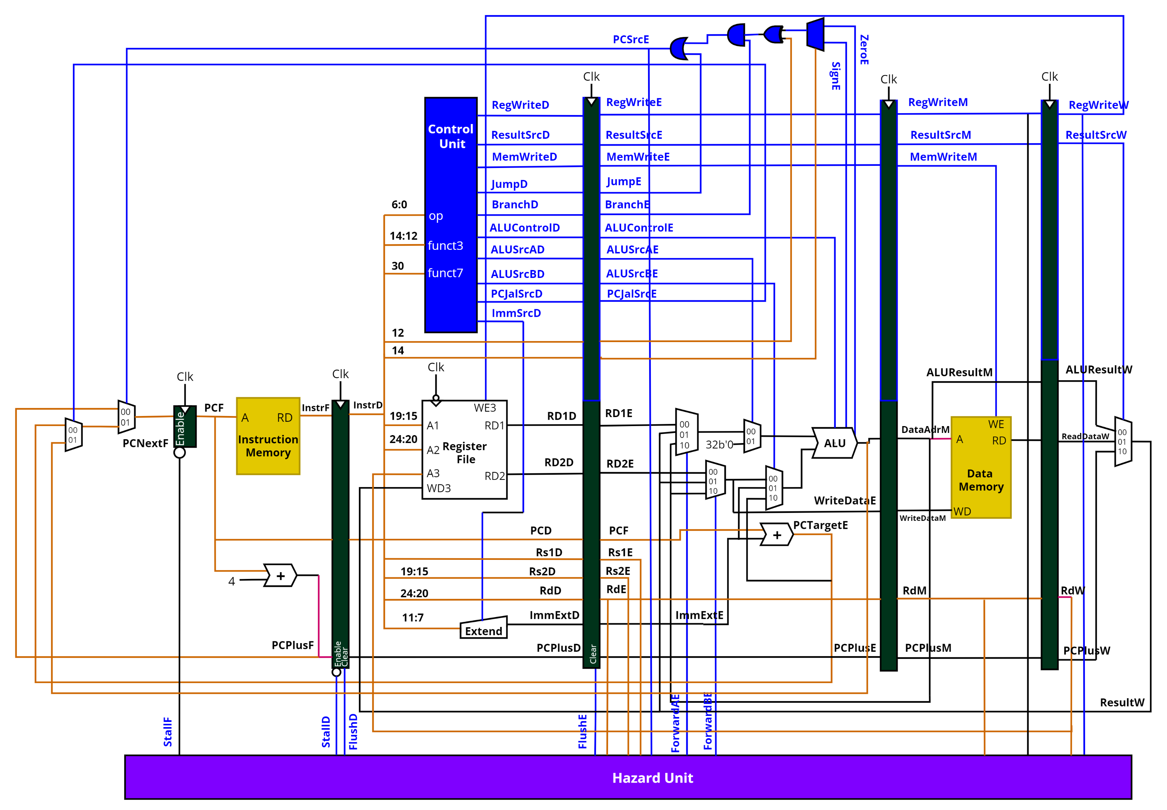
Proposed Microarchitecture (diagram created using Draw.io software)
Notes:
Orange – instr, Black – datapath, Blue – control signal
Name the 5 stages

Slide 6
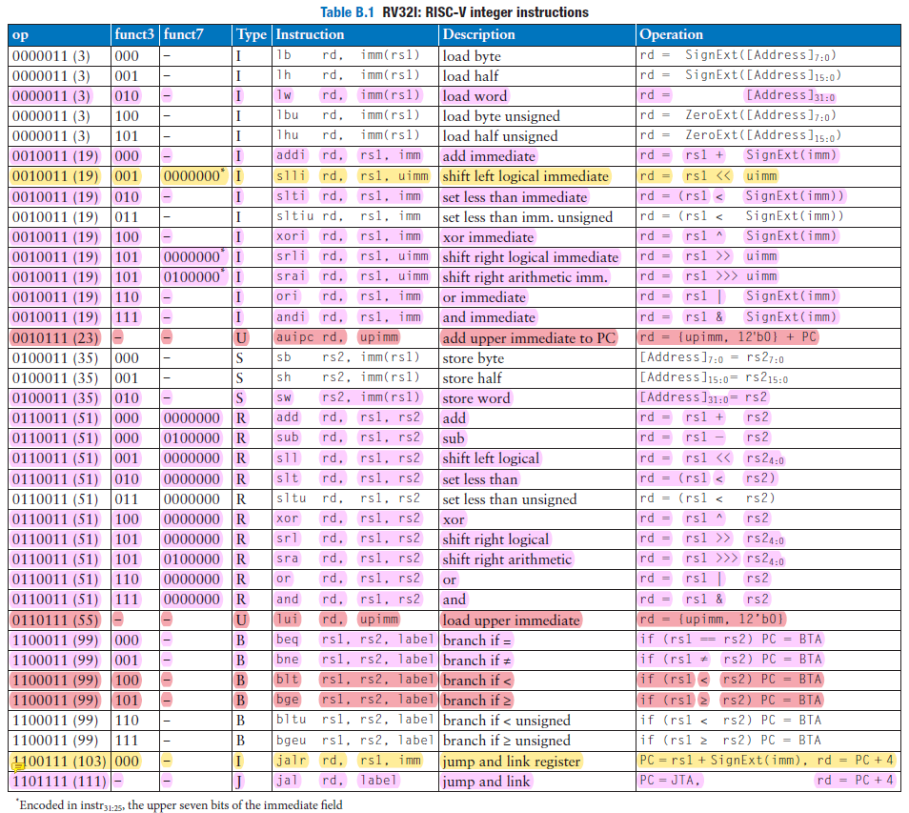
RV32I ISA
Need this for decoder design!
Notes:
Implemented 27 of the 37 instructions.

Slide 7
Types of Instructions
Immediate Extender unit uses this table

Slide 8
Features
Based on RV32I Core
Supports 27 instructions of the total 37 instructions
Basic Integer Processing (Add/Sub, Logical, Shift Operations)
5 – stage Pipeline design
Complete Hazard Handling (Data Hazards and Control Hazards)
Datapath – Controller Design
Modular and highly extensible
Notes:
Add some features, easily do so
Can be a core on a SOC Design

Slide 9
Design Steps
System Verilog used as the HDL

Slide 10
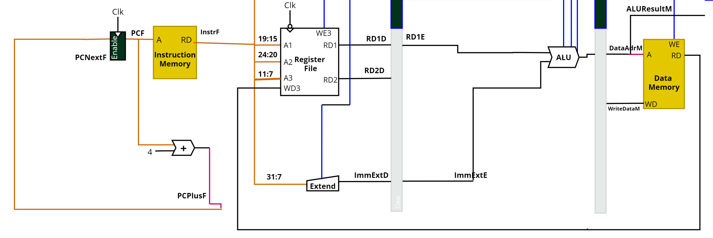
Load Word First
lw x1, 2(x7)
[x7 + 2] = x1
Notes:
Explain how it is designed from load word.

Slide 11

Store Word
sw x1, 9(x5)
x1 = [x5+9]

Slide 12
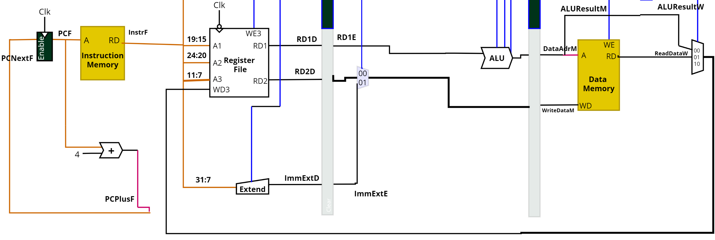
R - type
and x1, x2, x3

Slide 13
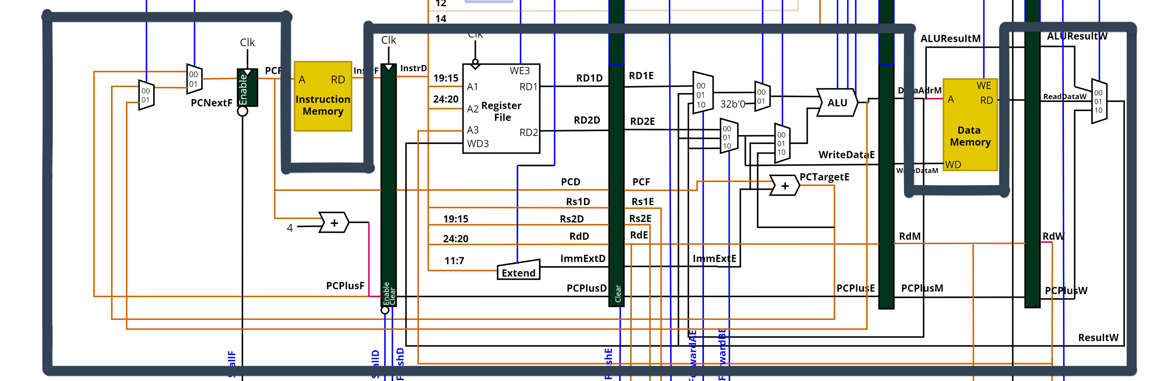
5 - stage Pipelined Datapath
Notes:
new instruction -> check if datapath already available. If not, add them.
Explain how pipeline is made

Slide 14
Control Unit (Split into two modules)
Main Decoder
ALU Decoder
Control Unit
Main Decoder
For determining the type of instruction
ALU Decoder
Determines the operation to be performed by the ALU
Notes:
Show controller unit datapath in system verilog. Explain it

Slide 15
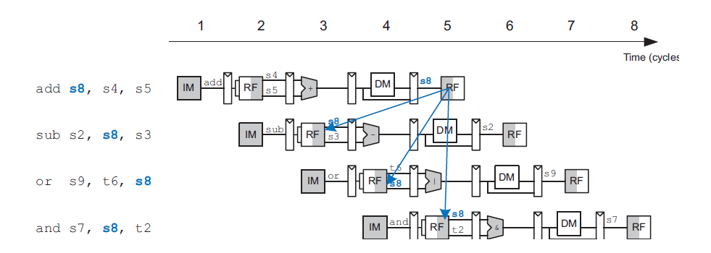
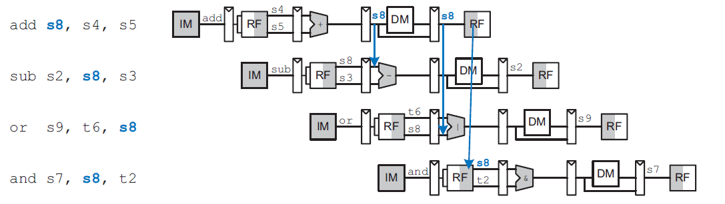
Hazard Handling
Occurs when an instruction depends on the results of the previous instruction which is not yet completed.
Data Hazards
Forwarding
Stalling ( for load word )
Control Hazards
Flushing
Data Hazard
Solution
Notes:
Include logic and examples for data hazards.

Slide 16
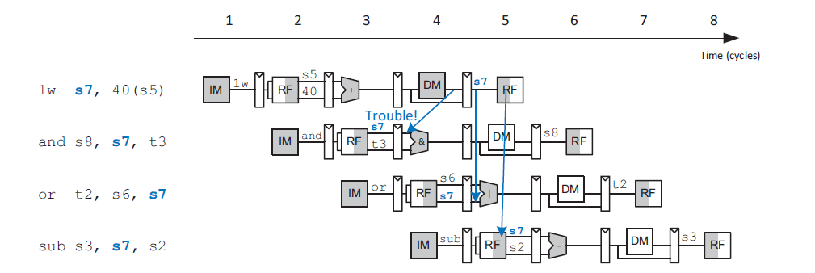
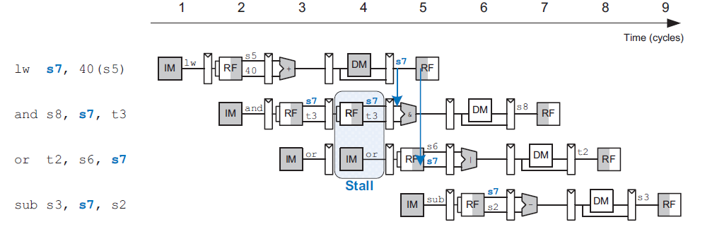
Stalling for load word hazard
Since the result of load instr. not available till the end of Memory Access Stage, we stall the next instructions by cycle.
When result appears in Write Back Stage, we forward it to the execution stage.
Load word hazard
Solution

Slide 17
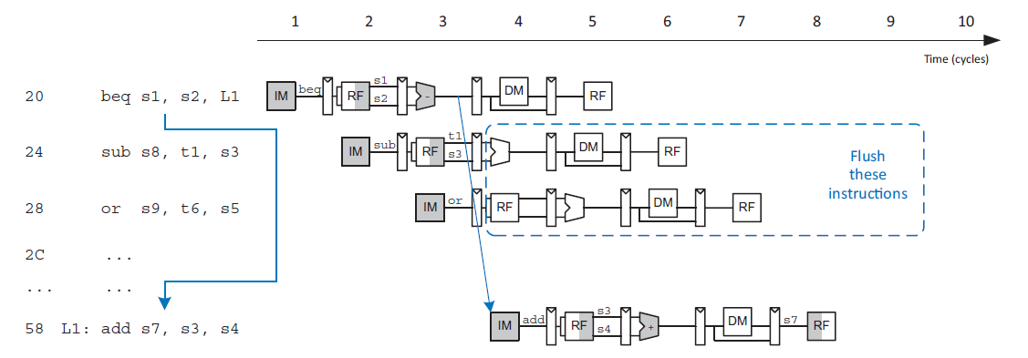
Control Hazards
We flush the following two instructions whenever the branch is taken. Flush decode and execute stage.
Notes:
Include logic and examples

Slide 18
Design steps summary
Implement Load Word Instruction first
Then Store Word Instruction
Modify datapath and decoder to include R - type
Add branch and store instructions (MUX for PC)
Debug and Verify
Pipeline the data path and the controller
Design Hazard Unit
Debug and verify
Notes:
And then show this steps

Slide 19
Simulation and Verification
Tools used: Intel Quartus Prime Lite, VS Code

Slide 20
Performance Measurement
Critical path, max. frequency, Average CPI

Slide 21
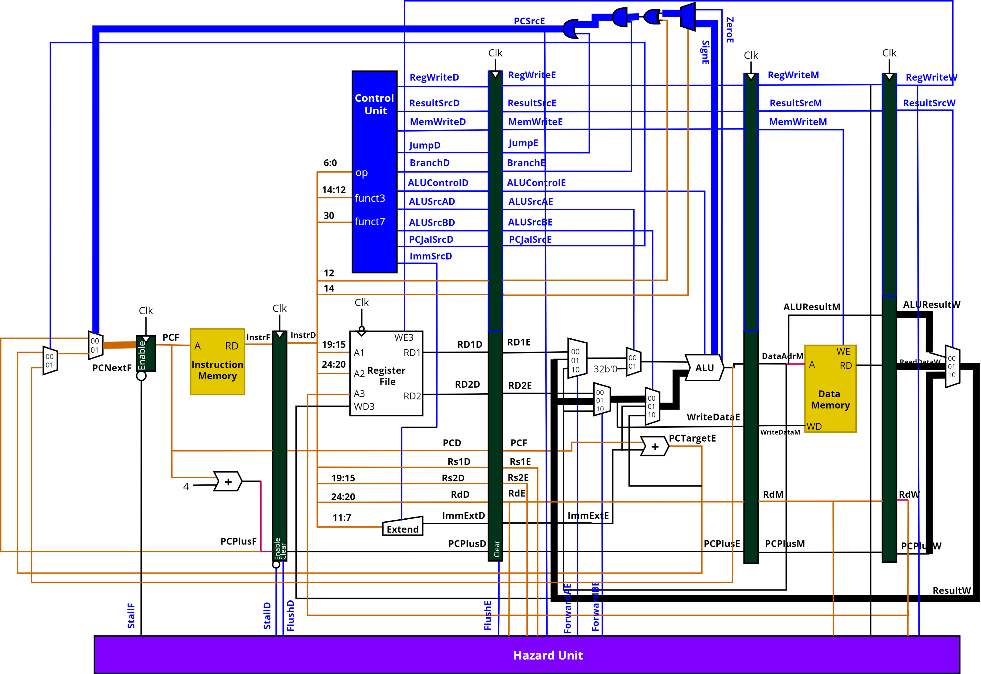
Critical Path

Slide 22
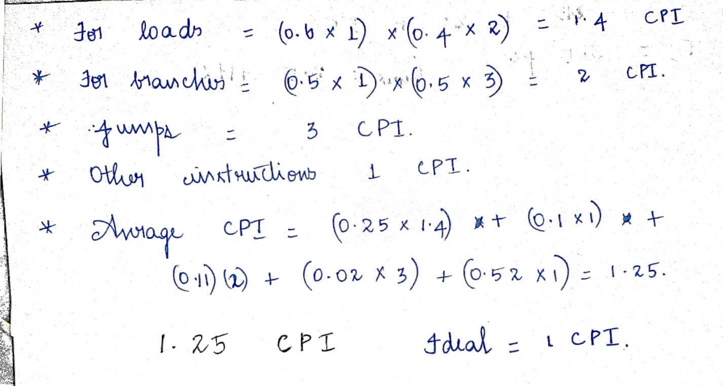
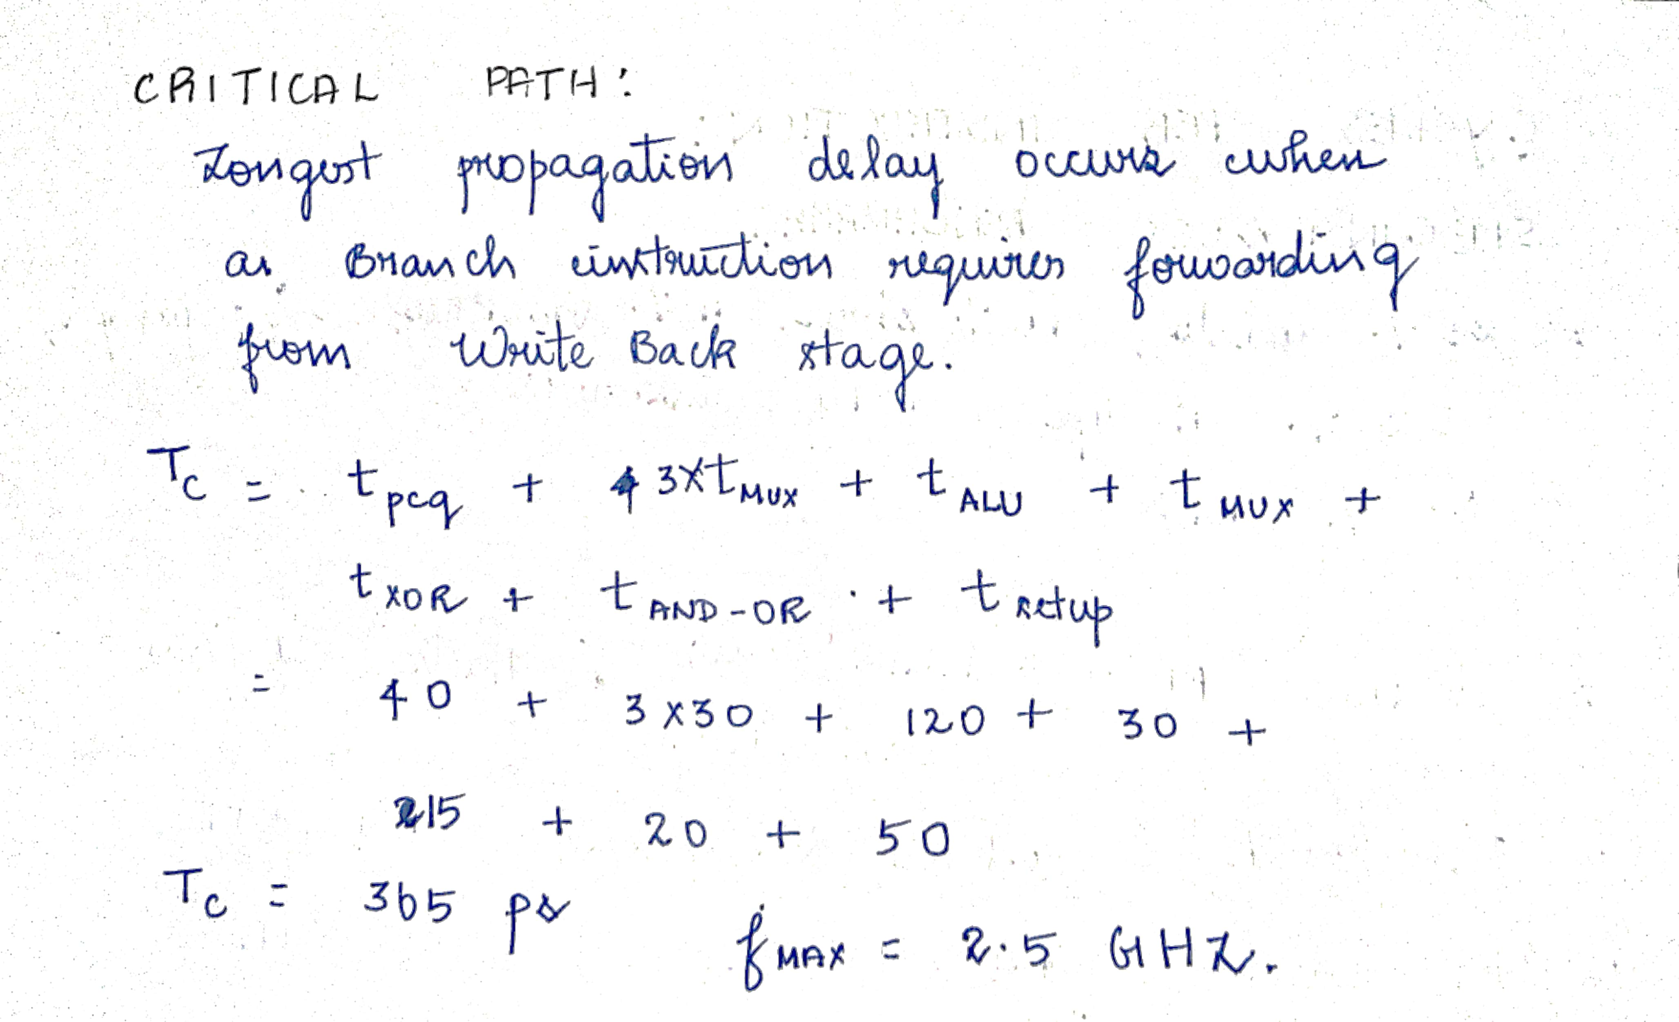
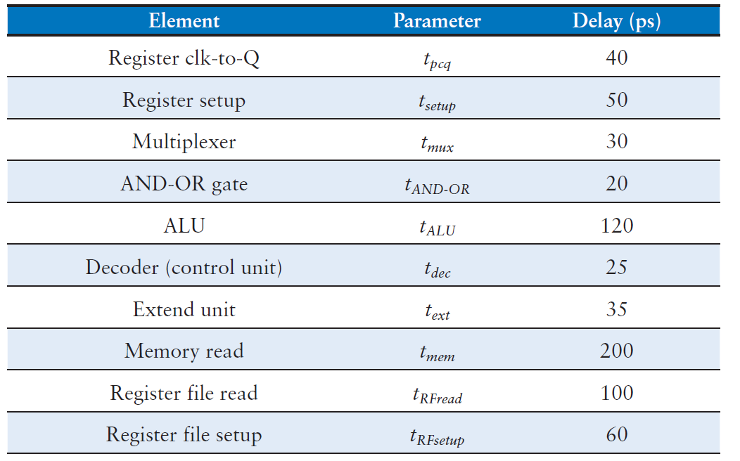
Performance Measurement
Notes:
Include Max clock frequency, power consumption

Slide 23
Future Goals
Implement superscalar architecture
Cache memory
Branch Predictor
More Pipeline stages

Slide 24
Thank You

